Slide 1
From Evidence to Impact: How the European Observatory on Health Systems and Policies Supports Health Policy
Dr Ewout Van Ginneken
Thursday 25 June, PHONZ26 International Health Intelligence

Slide 2
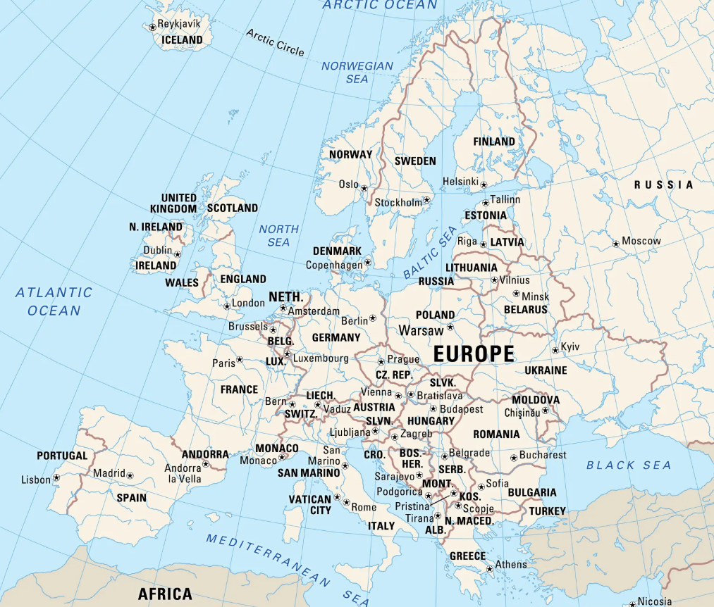
About 30 years ago in Europe
1991 Several ‘new’ Central and Eastern European countries were emerging after the dissolution of the Soviet Union
Western European health systems were facing high cost and increasing expectations of their citizenry leading to market-based reforms
Scant evidence was available on these reforms and their impacts to the emerging countries
SANT European Parliament - Feb 18, 2025

Slide 3

About 30 years ago in Europe
Ministers across the European region adopt the 1996 Ljubljana Charter on Reforming Health Care, which highlights the importance of comparative evidence
1998: creation of the European Observatory on Health Systems and Policies, (WHO, Norway, EIB, World Bank, LSE, LSHTM)
1998 - Dr Jo Eirik Asvall, WHO Regional Director for Europe
SANT European Parliament - Feb 18, 2025

Slide 4

The European Observatory Partnership today
WHO EURO
The European Commission
Governments of
  Austria
  Belgium
  Finland
  Ireland
  Netherlands
  Norway
  Slovenia
  Spain
  Sweden
  Switzerland
  UK
  Veneto Region + Agenas
CNAMS France
Health Foundation UK
LSE
LSHTM
SANT European Parliament - Feb 18, 2025

Slide 5

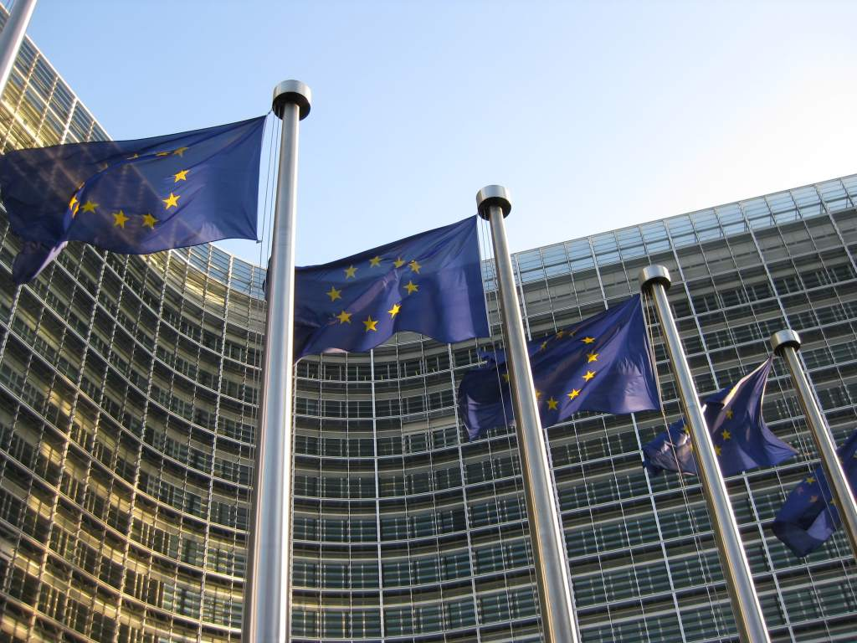
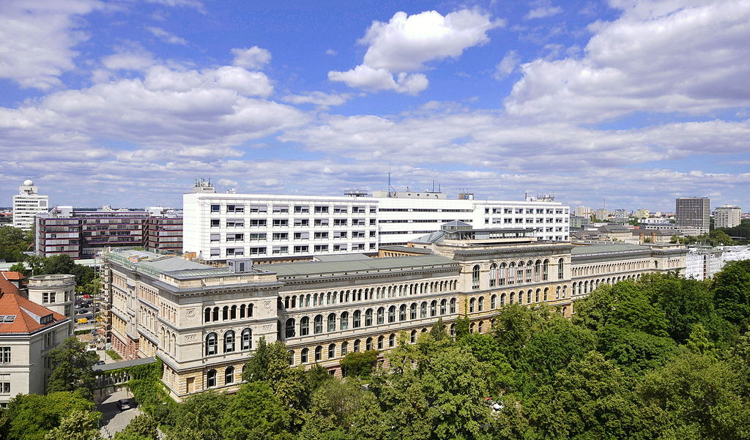
The Observatory hubs and staff team
Hubs allow the Observatory to embed staff
(i) close to policy makers and,
(ii) close to academia to tap into cutting edge academic research and expertise and give it a policy focus.
The Brussels team leads, coordinates analysis and shapes knowledge brokering and manages partnership.
The London team is split between London School of Economics and Political Science and London School of Hygiene & Tropical Medicine.
The Berlin team sit at the Technische Universität Berlin.
SANT European Parliament - Feb 18, 2025

Slide 6
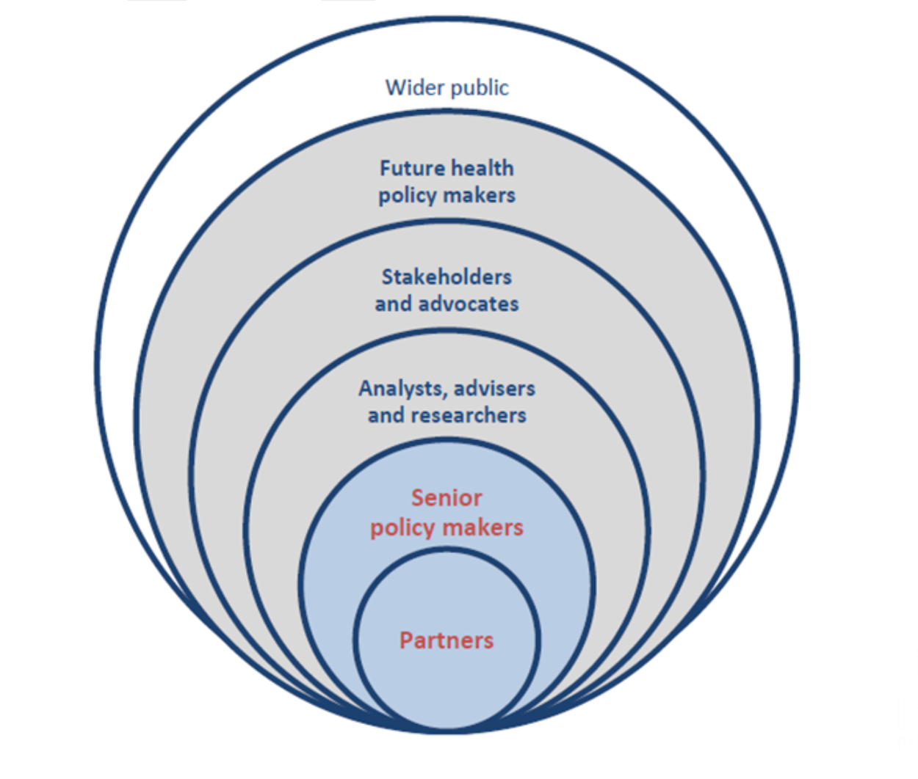
What the Observatory does
The Observatory has four functions
Country monitoring
Analysis
Health systems performance assessment (HSPA)
Knowledge brokering
Knowledge brokering – the notion of a cycle where analysis is informed by policy need – underpins them all as do a commitment to relevance, quality, objectivity (the non-normative) and responsiveness.
SANT European Parliament - Feb 18, 2025

Slide 7
Country monitoring

Slide 8
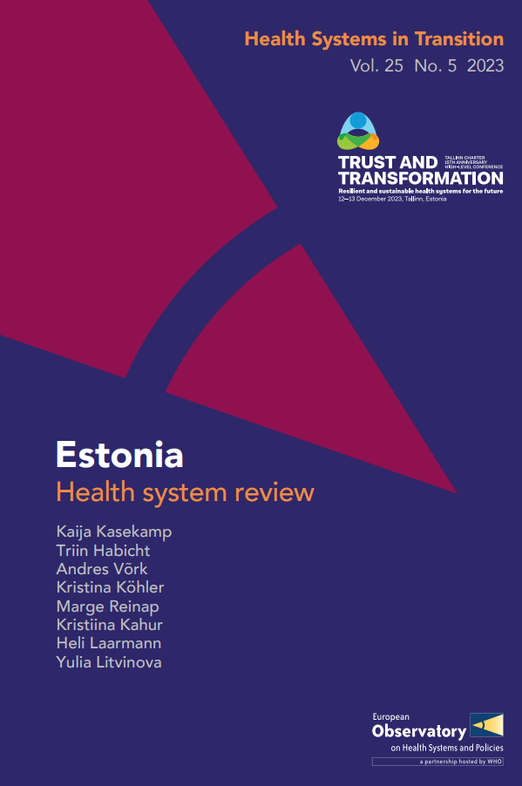

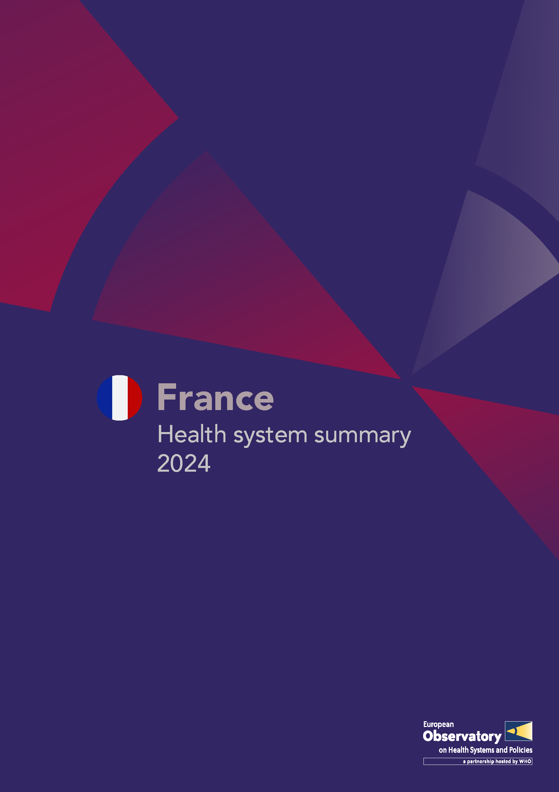

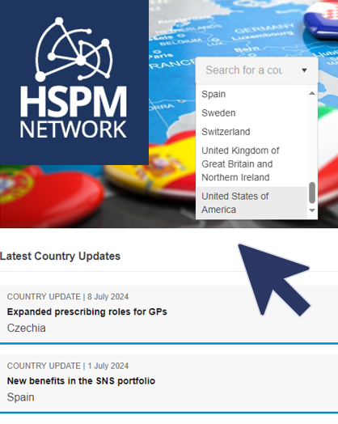

Country monitoring portfolio
1. Health systems in Transition (HiT) reviews
4. Health and the Economy Snapshots
2. Health System Summaries
5. SoHEU Country Health Profiles
3. Health Systems in Action (HSiA) Insights
6. HSPM Country updates
and Policy Analyses

Slide 9

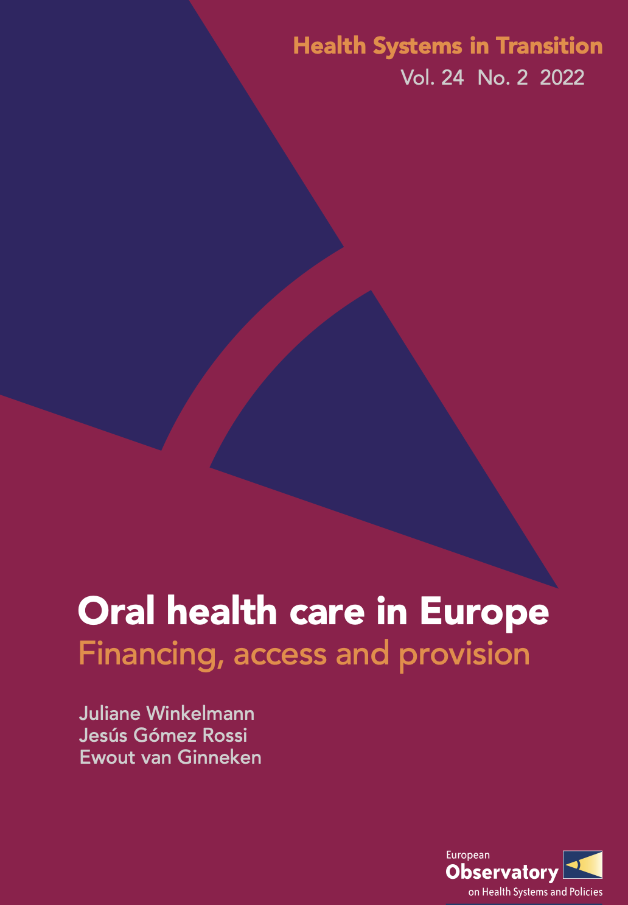
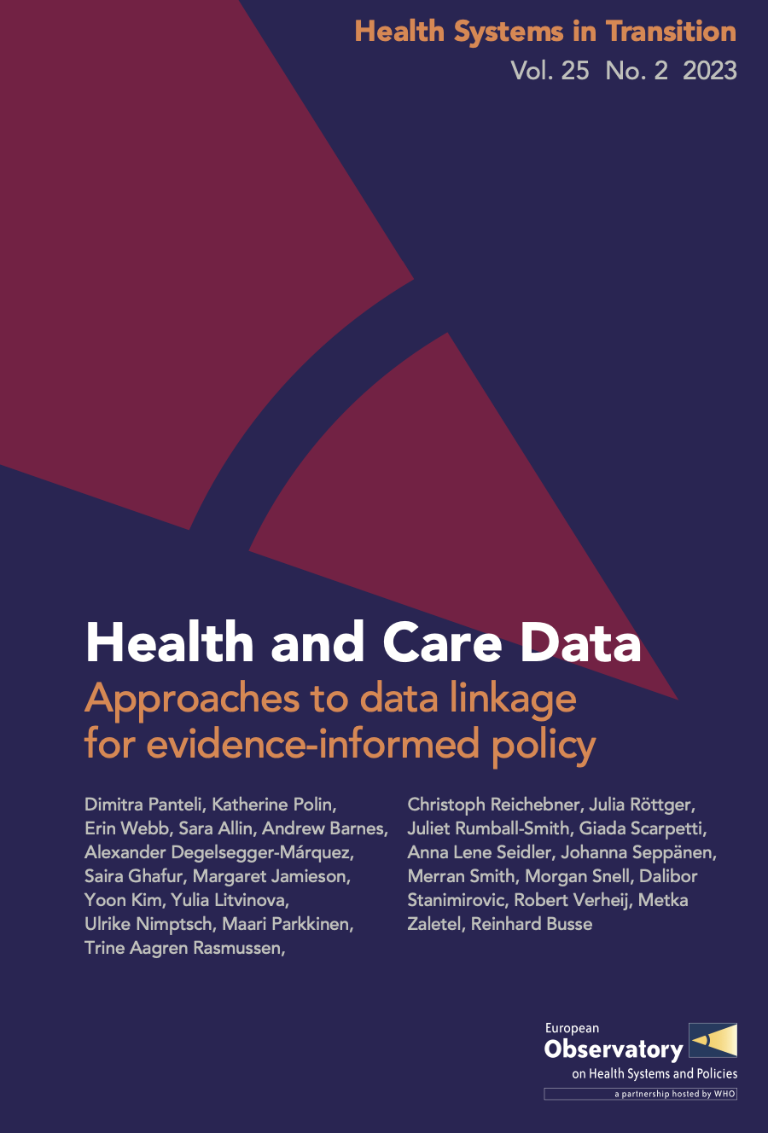
Cross-country HiTs

Slide 10
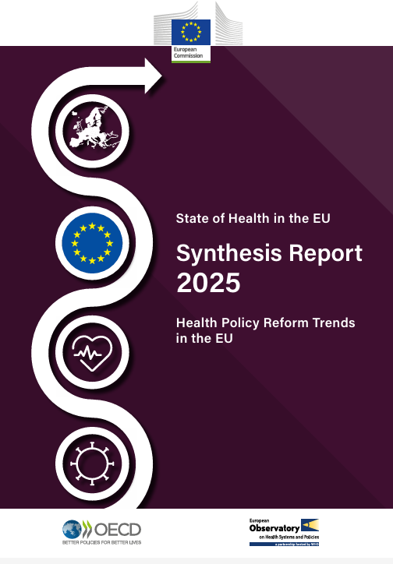



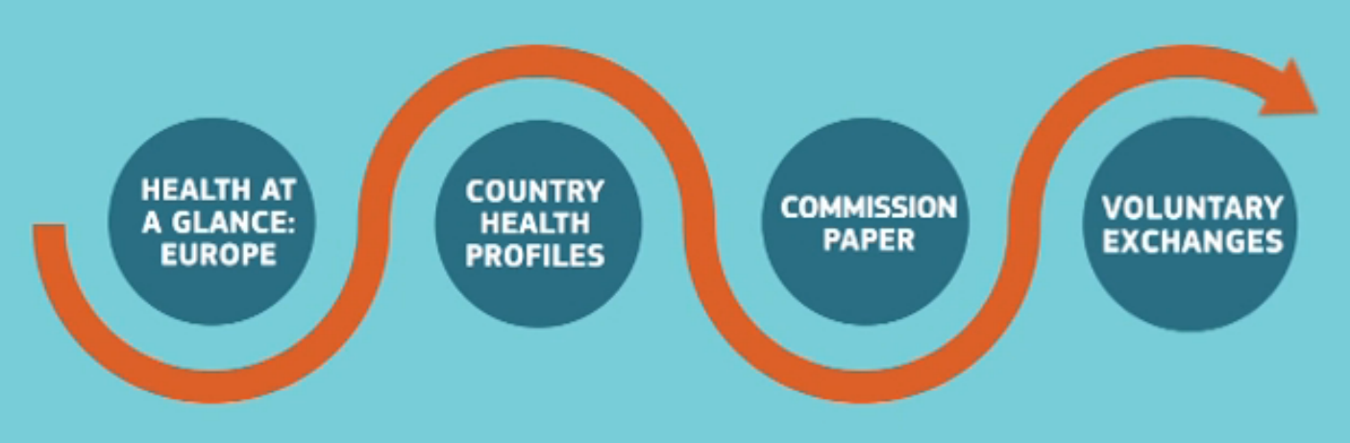
State of Health in the European Union

Slide 11
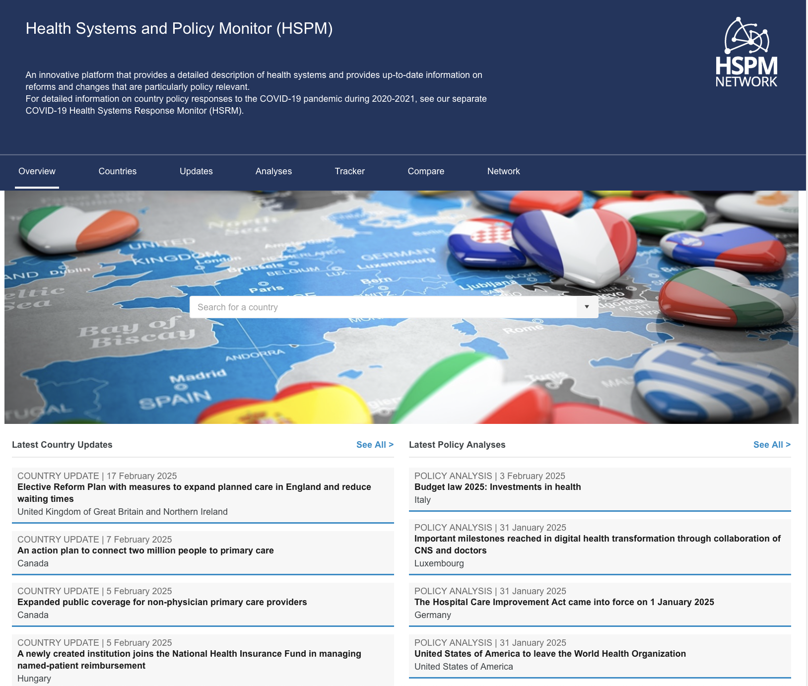
HSPM website

Slide 12
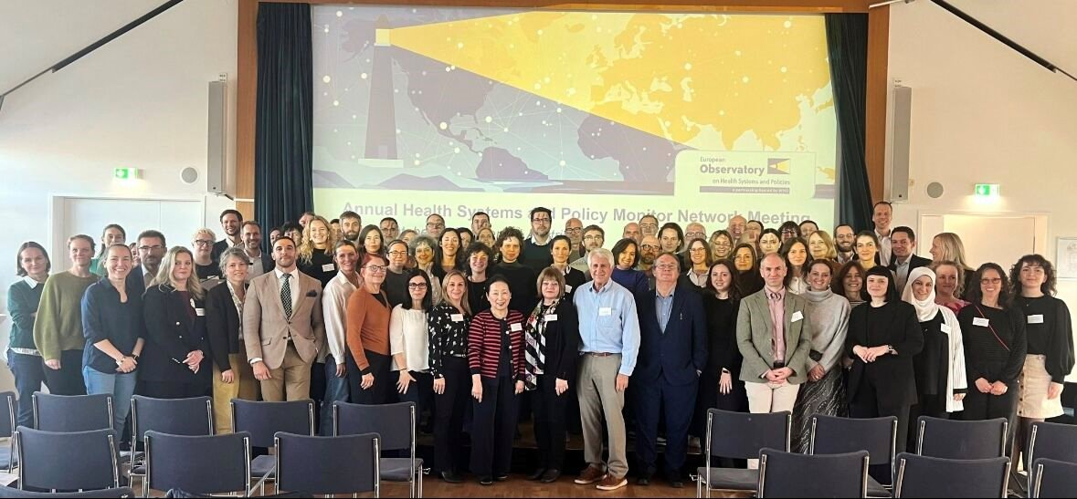
Growing role of the HSPM network
Has developed over the last 15 years as a network and a core Observatory resource
Provides the backbone for country monitoring in EU Member States (and beyond)
Helps cement the Observatory’s reputation as a leader in health system evidence
Activities include HiTs, updating HSPM and HSRM, reviewing SoHEU profiles, webinars, rapid responses, articles for Eurohealth and Health Policy
2025 Network Annual Meeting in Vienna

Slide 13
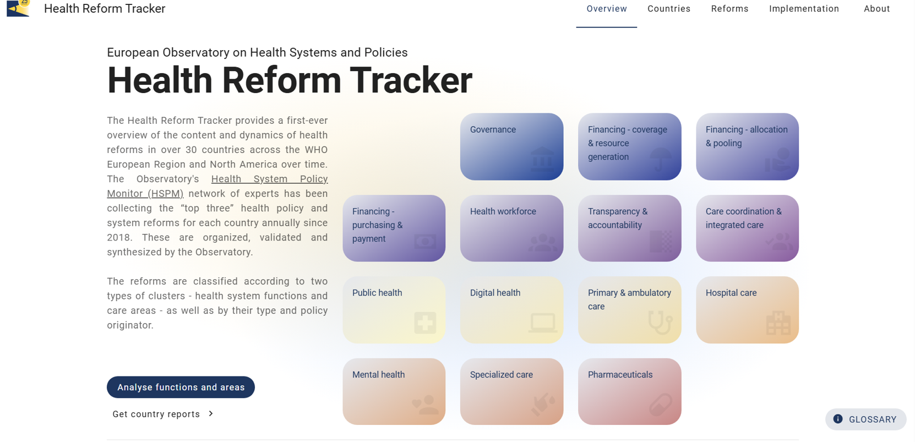
Health Reform Tracker: mapping themes and patterns
SC June 2025

Slide 14
Health System Performance Assessment

Slide 15

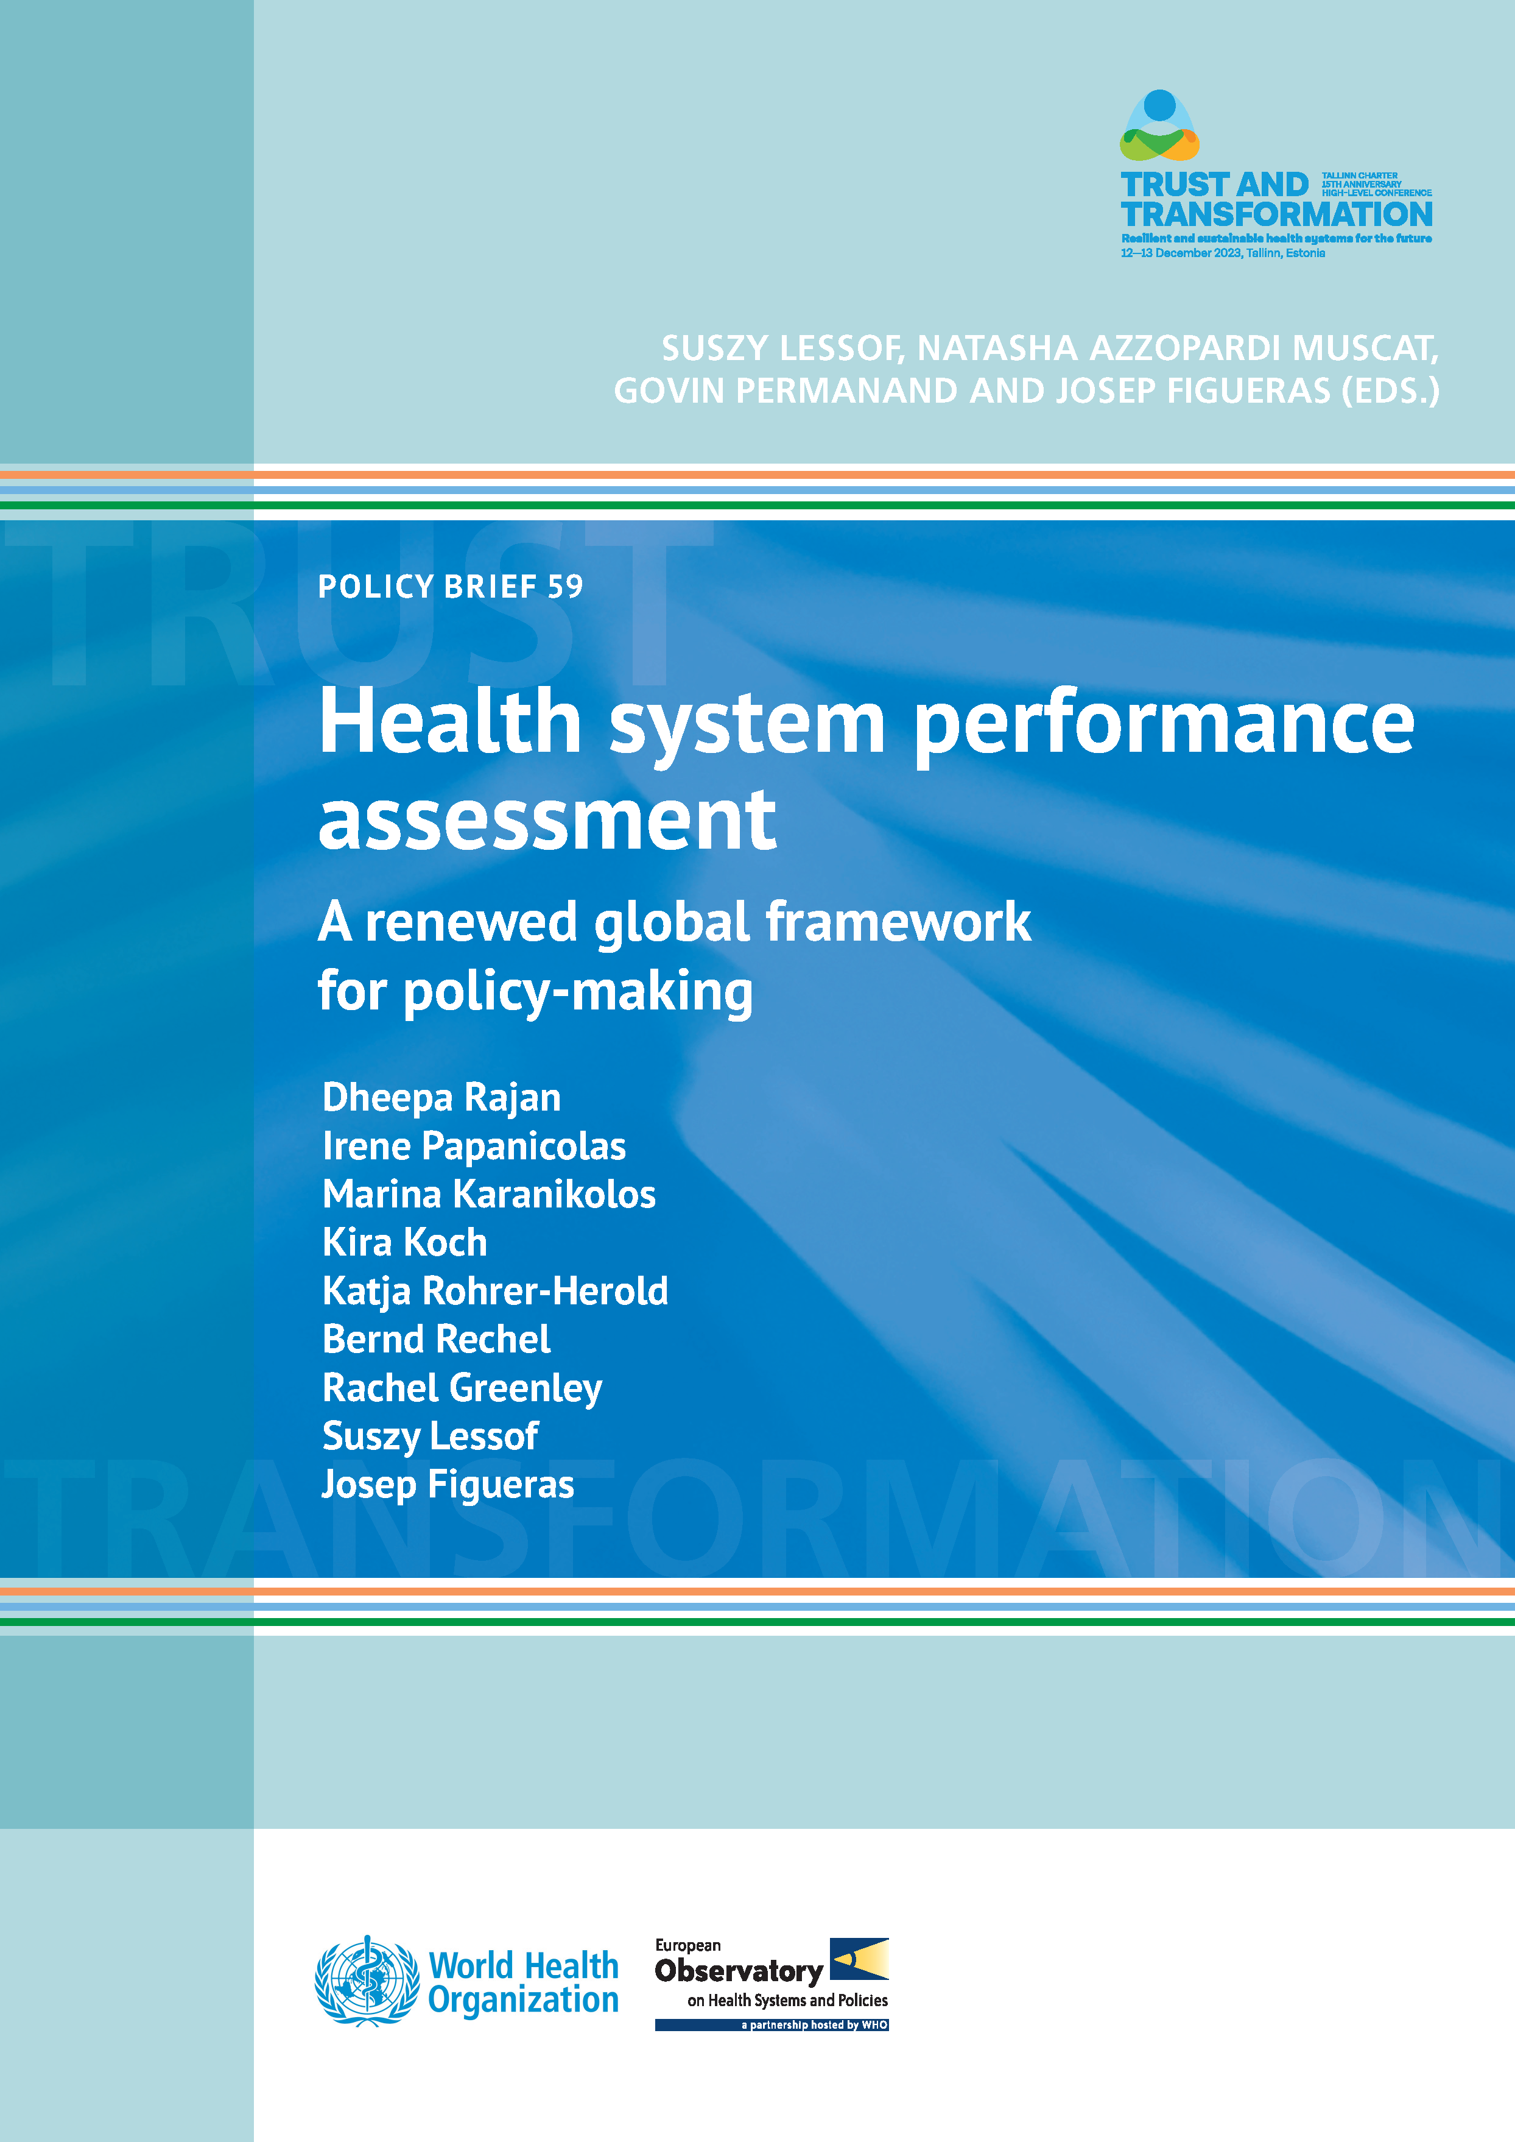

The Observatory tools : HSPA
Key instrument for EU & Member States
Monitoring of common health system goals of interest – health outcomes, equity, efficiency, resilience, sustainability
EU-wide comparability - benchmarking
Alignment with EU health policies
Feedback on EU policy instruments (Recovery & resilience fund, EU Cancer Mission...)
EU Expert Group on HSPA
Best practices and cross-country learning
Cross-border performance assessment
SANT European Parliament - Feb 18, 2025

Slide 16
Context (socioeconomic, political and cultural), shocks
Context (socioeconomic, political and cultural), shocks
Health Systems Performance Assessment Framework
Function and sub-functions
Intermediate
objectives
Final goals (UHC
& health security)
Resource generation
Health workforce
Societal goals
Governance
Infrastructure and
Environmental
medical equipment
Ef?ciency
Equity
of service delivery
of service delivery
Efficiency
Equity
of health system
of health system
sustainability
Governance
Pharmaceuticals and
other consumables
Policy and vision
Service delivery
Effectiveness
People-centredness
Multisectoral collaboration
Public health
Societal
wellbeing
Population and civil society
Governance
Safety
participation
Primary care
Health improvement
Information and (digital)
Financing
User experience
knowledge
Specialized care
Legislation and regulation
Revenue raising
Access
Financial protection
Governance
Pooling
Quality
Purchasing
Performance and
resilience links
within health system
Intersectoral
performance links
Structural /
socioeconomic determinants of health
functional links
SANT European Parliament - Feb 18, 2025

Slide 17
Analysis

Slide 18


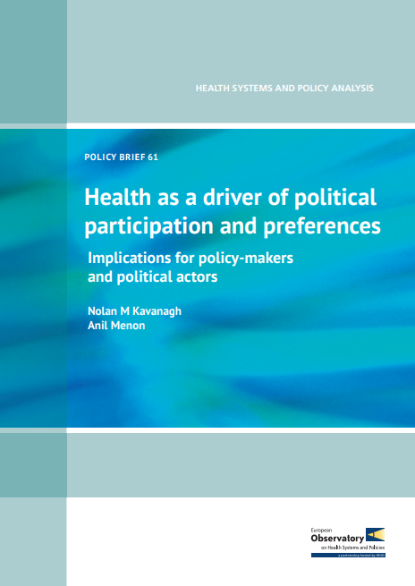
What analysis is and how it helps
Analysis supports policy-makers through a range of formats
In-depth analysis with primers on key areas and studies of major issues that reflect country health system priorities
Policy briefs that focus on the evidence and options around a specific and topical policy question
Short studies, case studies and articles on aspects of an issue or to illustrate country experience
Rapid evidence responses that tackle emerging concerns and support Partners
SANT European Parliament - Feb 18, 2025

Slide 19

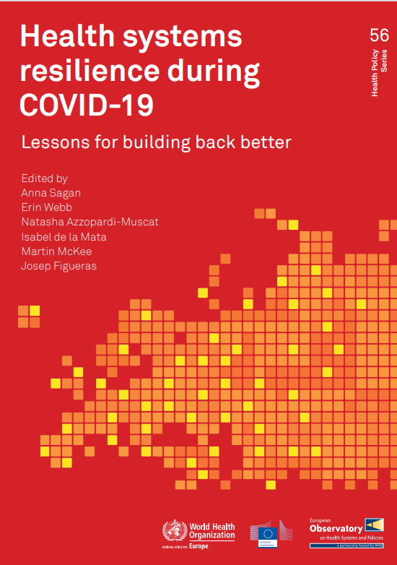



What analysis is and how it helps
SANT European Parliament - Feb 18, 2025

Slide 20



What analysis is and how it helps

Slide 21
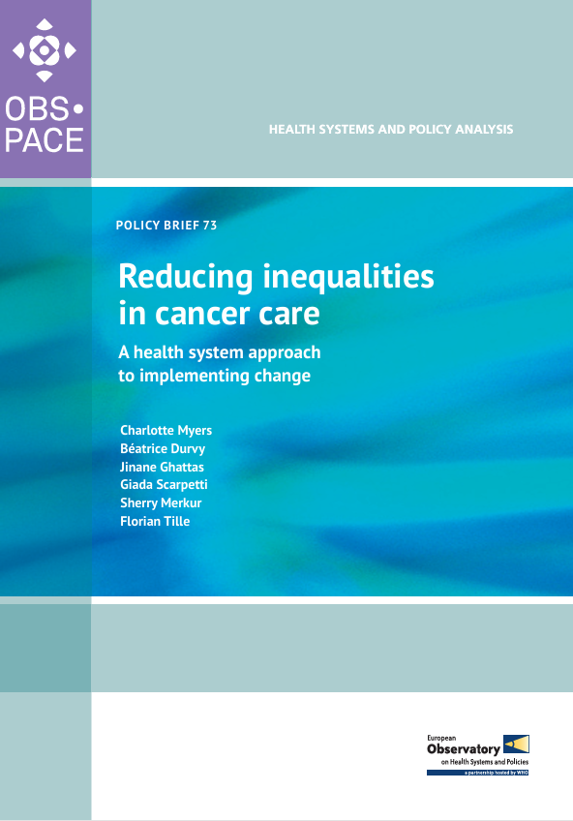
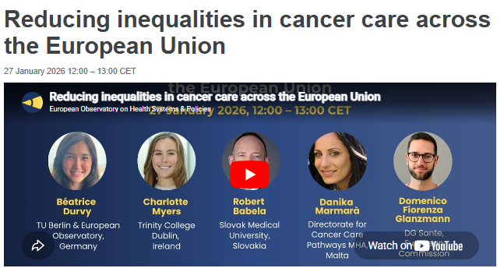
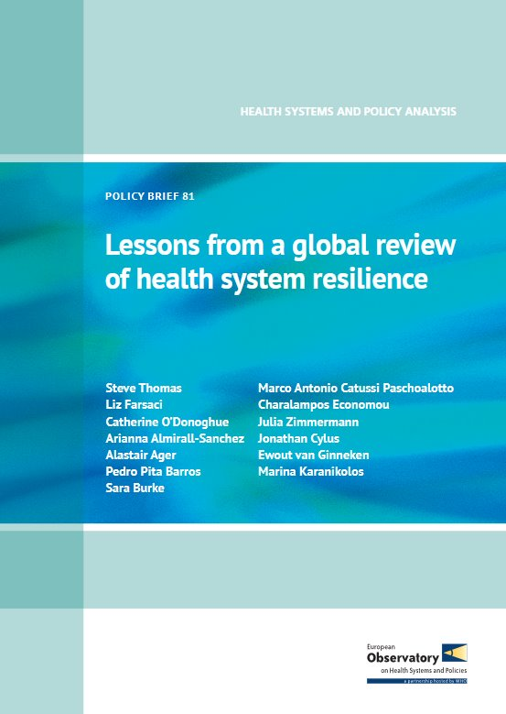
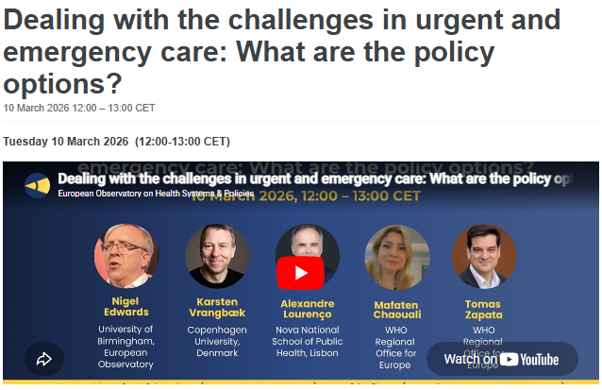
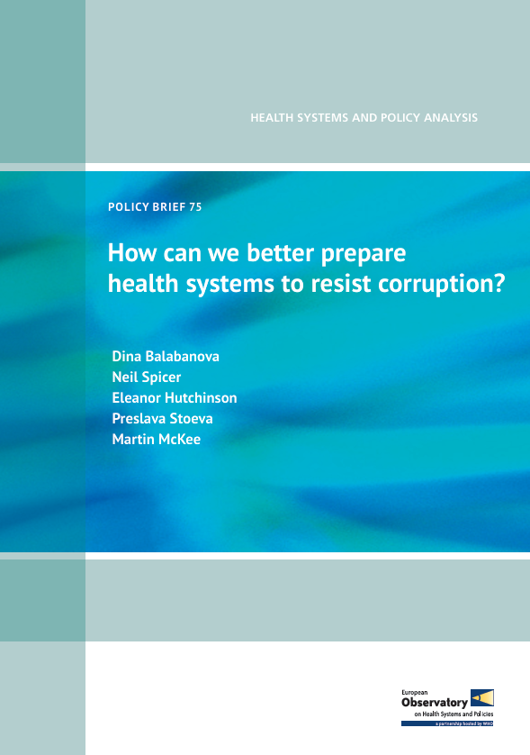
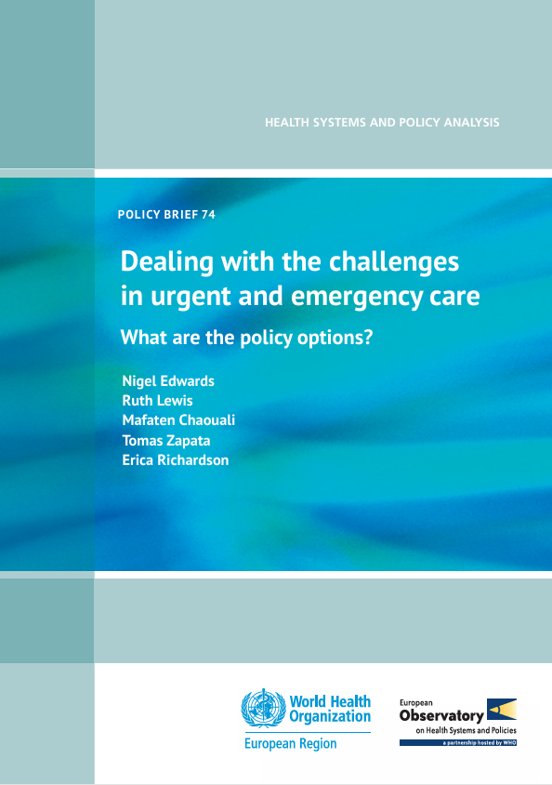
Activity reporting highlights – Analysis
New policy briefs on
Advancing equity in cancer care
Lessons from a global review of health system resilience
How can we better prepare health systems to resist corruption?
Challenges in urgent and emergency care with WHO
Launch webinars, sustained communications (newsletter, website, social channels, health policy platform, YouTube)

Slide 22
Knowledge brokering

Slide 23

Knowledge brokering
Overview
Policy Seniority
of participants
Choosing the right format!
Face-to-face engagements
  Policy dialogues, Evidence briefings, etc.
  OBS Venice Summer School
Webinars
Policy Briefs
Articles, papers
  Eurohealth journal
  Health Reform Monitor (Health Policy)
Policy
dialogue
Policy
round table
Focused briefing
Summer
School
Workshop
Seminar
Conferences
Decision making
proximity

Slide 24
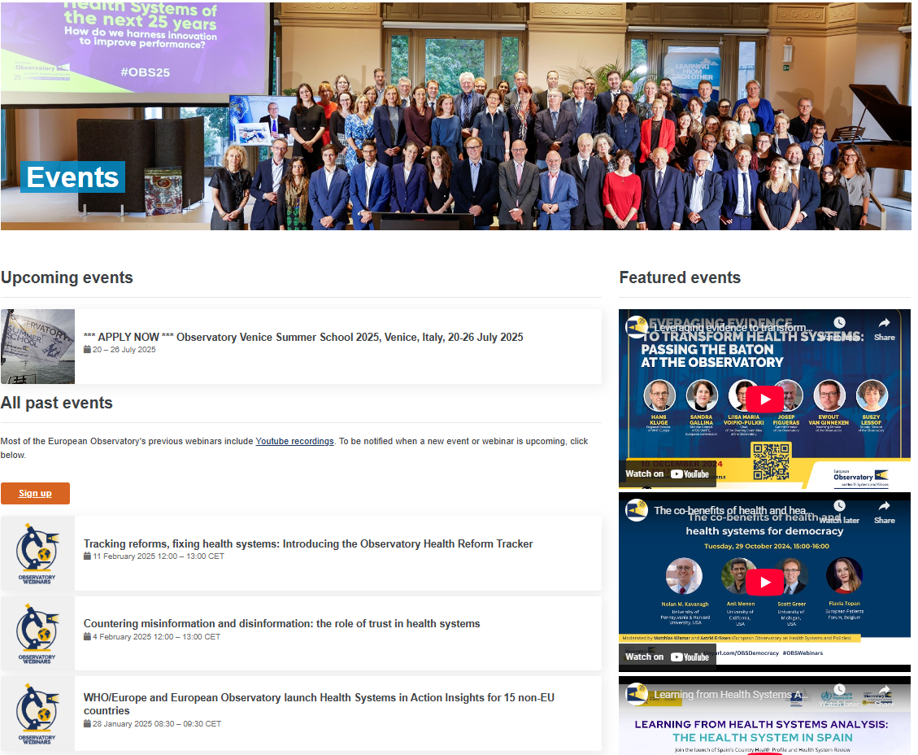
Webinars

Slide 25

Packaging evidence to increase access: Eurohealth
We launch them during events like EUPHA, Gastein Forum, and presidencies..
Irish EU Presidency issue will be ready for July​
SC June 2025

Slide 26
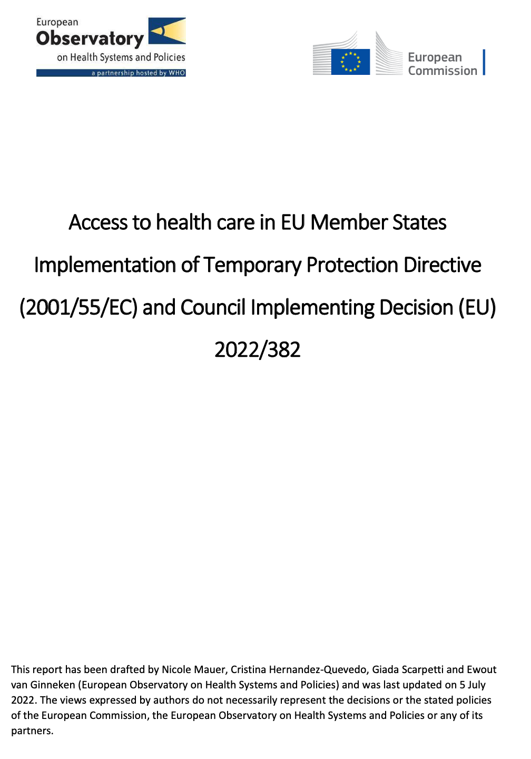
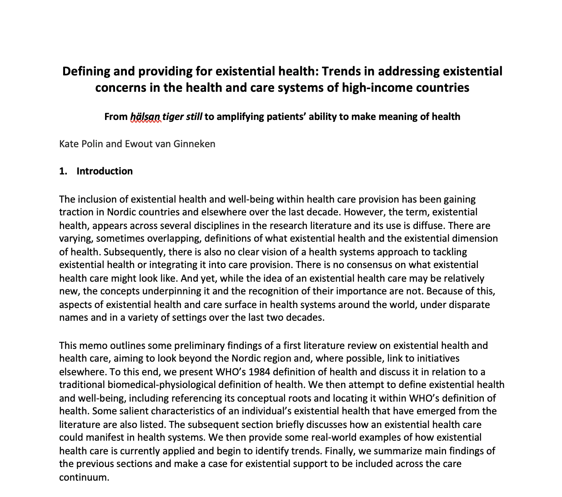
Rapid responses

Slide 27
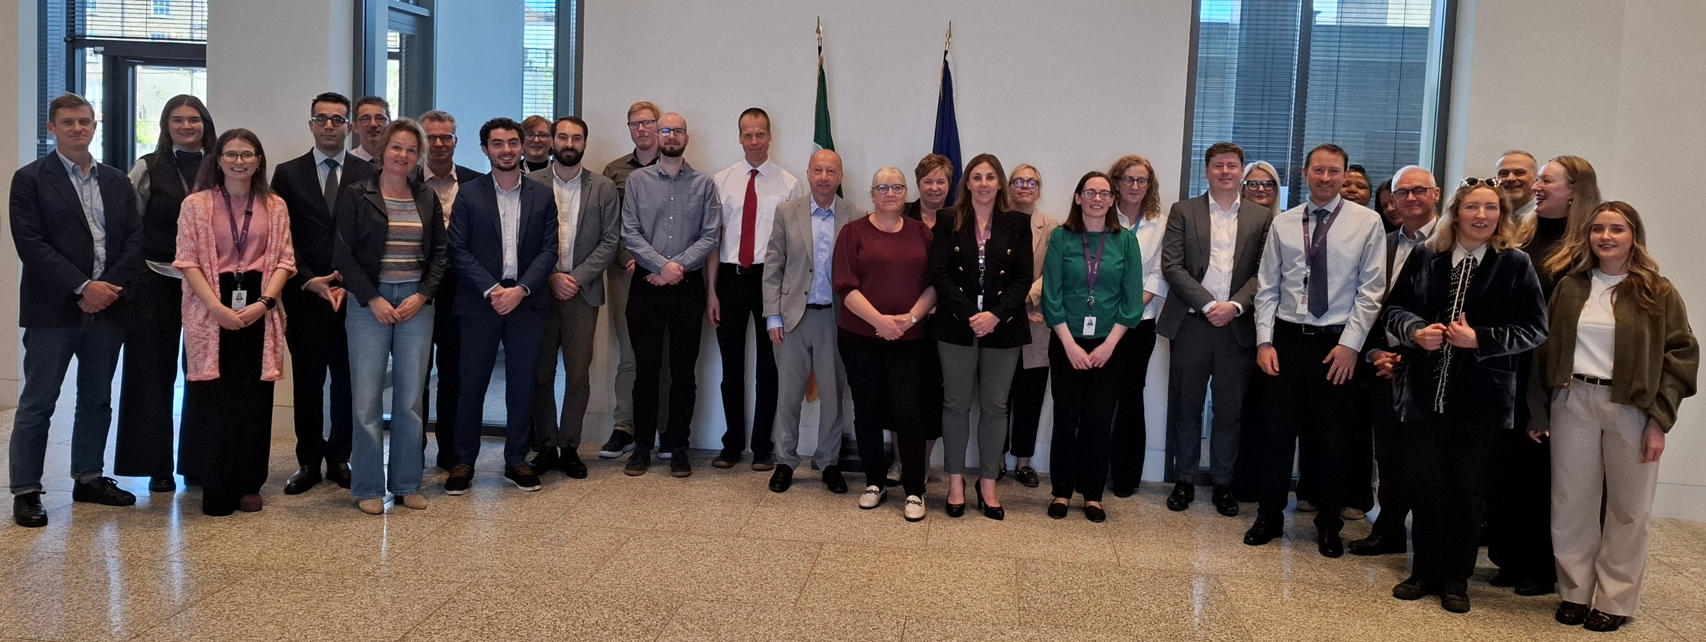
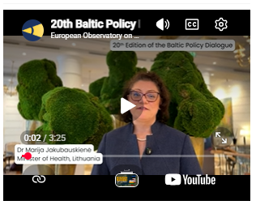

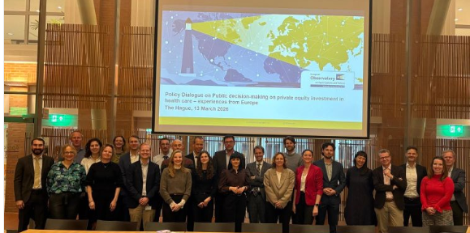
2026 Policy dialogues on
Private equity investment in health care in the Netherlands and Europe
Private equity investment in long-term care in Ireland
Health services for nursing home residents in Ireland
Health financing policy options amid budget constraints in Ireland
Better alignment between primary care and hospitals in Norway (SoHEU)
Health system performance assessment & performance pathways in Estonia (SoHEU)

Slide 28
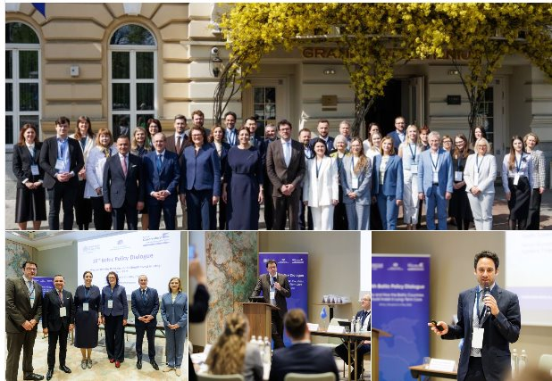
Baltic Policy Dialogue – 20th edition!
Free movement in health care: a sub-regional approach to cross-border care and health professional mobility (Tallinn 2013)
Investing in integrated care solutions to manage multiple and chronic conditions: analysing evidence, sharing experience and exploring implications (Vilnius 2014)
Ensuring access to new medicines in the Baltics: exploring strategies and options for pricing, reimbursement, usage and collaboration (Riga 2015)
Strengthening primary care: implementing change towards better coordination and more multi-professional working (Tallinn 2016)
Improving quality of care and ensuring patient safety: strategies, regulation, monitoring and incentives (Vilnius 2017)
Ensuring universal health coverage in the Baltics: exploring policy options to improve performance (Riga 2018)
Transforming hospitals to better serve local communities: options, challenges and strategies for integrated care networks in the Baltics (Viljandi 2019)
Revisiting pharmaceutical policies in the Baltics: ensuring sustainable and affordable access to effective and novel medicines (Vilnius 2022)
Towards digitally enabled integrated primary care

Slide 29
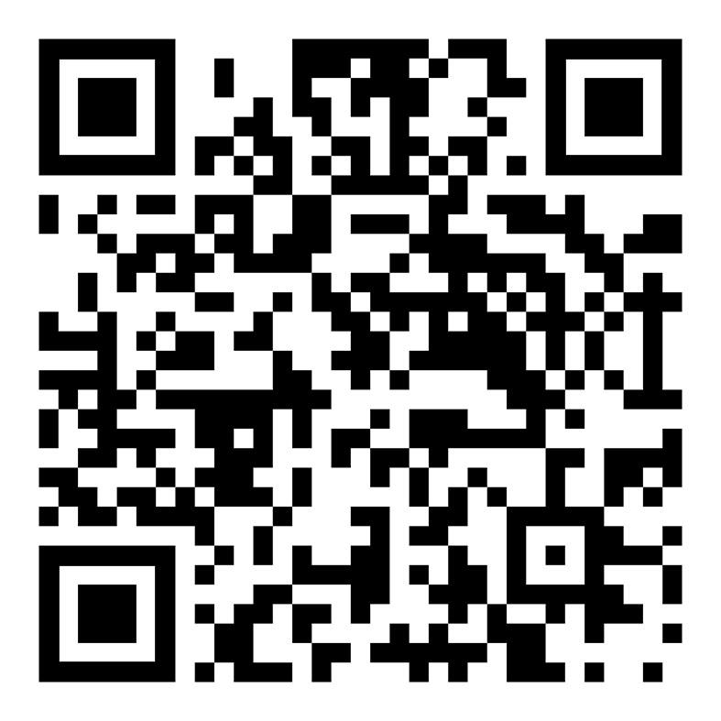

  To sign up for e-alerts, visit
  www.tinyurl.com/OBSupdates
  or scan the code:
Thank you!
  To visit the Health Reform Tracker, visit
  www.obshealthreformtracker.com
  or scan the code:
www.healthobservatory.eu
Twitter @OBShealth

